Slide 1

Movie Voting Analysis
Group V
Chan Un In, Yuni (MB955057)
Shu Zheng (MB955180)
Zhou Mengyuan (MB955265)

Slide 2




Data Analytical Process
Data Cleaning & Processing

Slide 3


Data Source
Movies released on or before July 2017
https://www.kaggle.com/rounakbanik/the-movies-dataset
Datasets
Movies_metadata.csv (32.8MB)
24 columns and 45455 rows
Info (title, year, genres…)
Popularity
Ratings (vote_count, vote_average)
Credits.csv (181MB)
3 columns and 45504 rows
Cast; Crew; id

Slide 4
Aims
Voting vs Popularity
Simple Personalized Output
Ratings
Genres
Crews (e.g. directors)

Slide 5





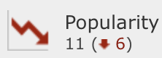
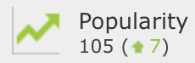


Slide 6

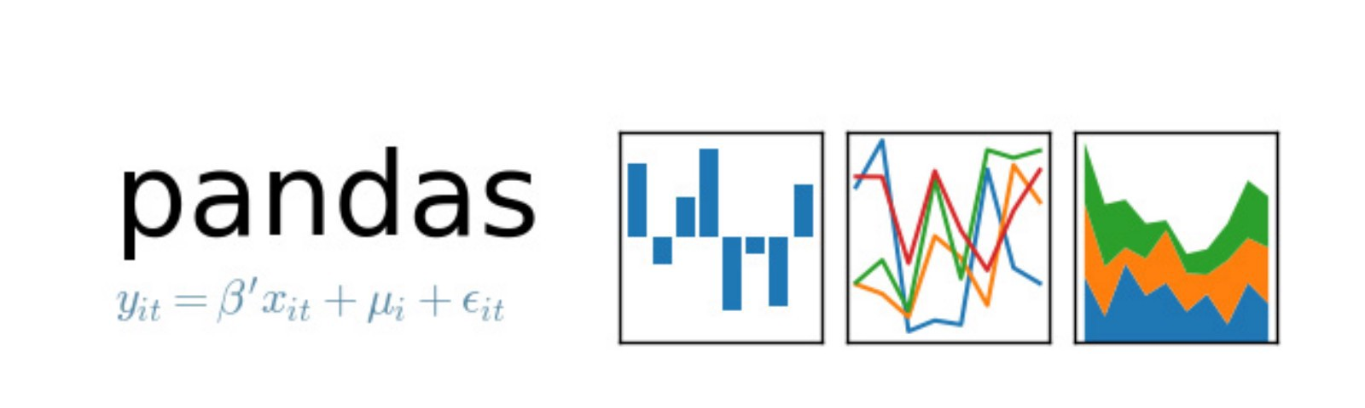



Libraries
Scipy.stats
Ast.literal_eval

Slide 7
Data Cleaning
pandas Dataframe.fillna(‘[]’)
Movies_metadata.csv
Drop abnormal id values
Credit.csv

Slide 8
Data Processing
Movies_metadata.csv
Apply()
Extract md[‘year’] from md[‘release_date’]
Transform md[‘popularity’], md[‘vote_count’] and md[‘vote_average’] ➔ float format
Genres
apply(literal_eval) ➔ Turn rows from str to list
Extract items from dictionary form
Credit dataset
Crew

Slide 9
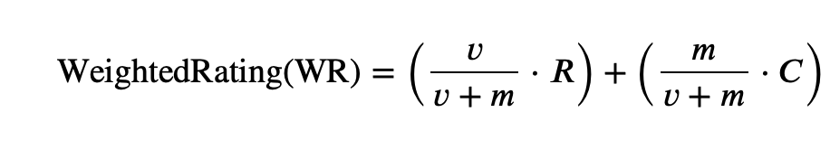
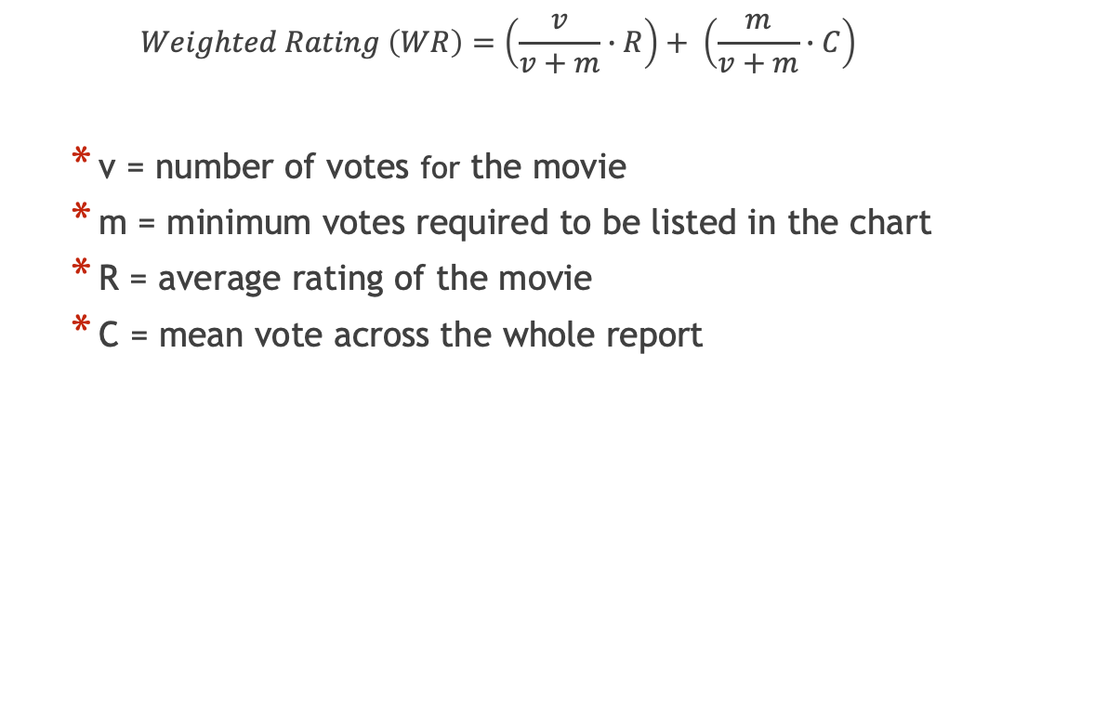
IMDb’s Weighted Rating (WR)
$$Weighted Rating \left(WR\right)=\left(\frac{v}{v+m}∙R\right)+ \left(\frac{m}{v+m}∙C\right)$$
v = number of votes for the movie
m = minimum votes required to be listed in the chart
R = average rating of the movie
C = mean vote across the whole report

Slide 10
Data Visualization

Slide 11
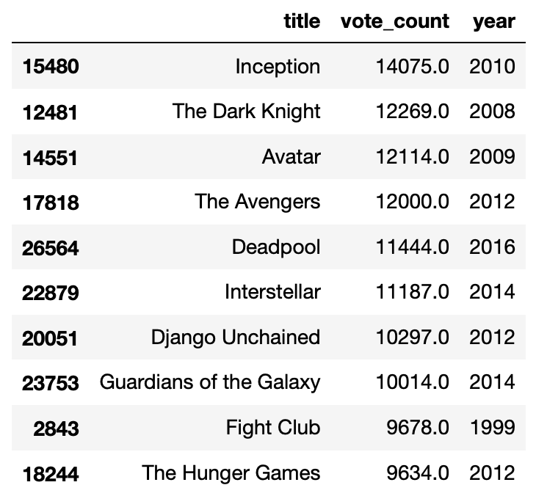
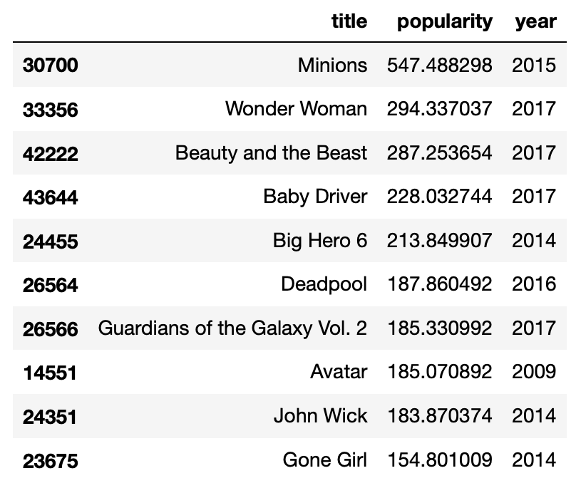


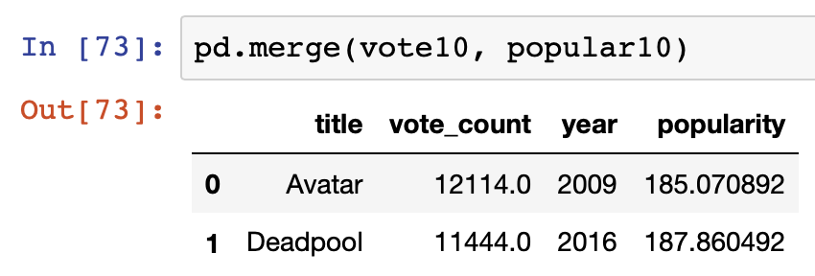
Top 10 Movies

Slide 12
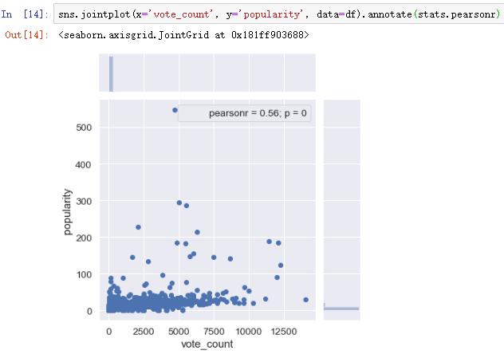
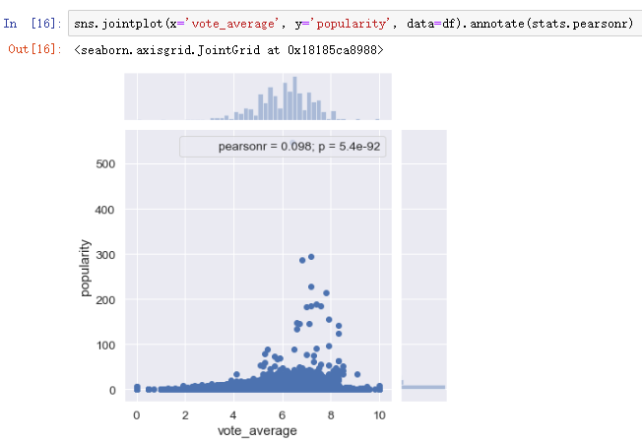
Seaborn library
Correlation between ‘vote_count’, ‘vote_average’ and ‘popularity’
Calculate Pearson Correlation Coefficient
scipy.stats.pearsonr

Slide 13

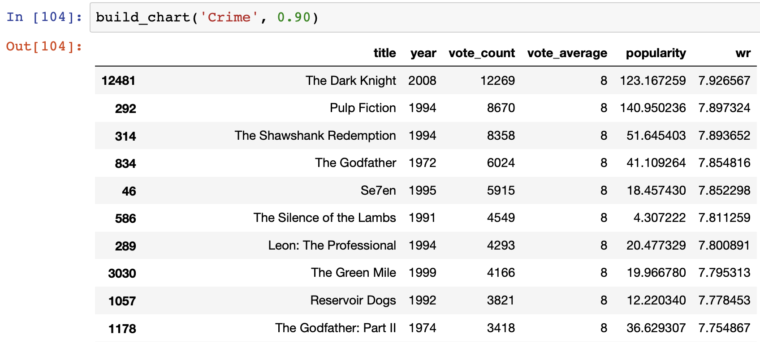
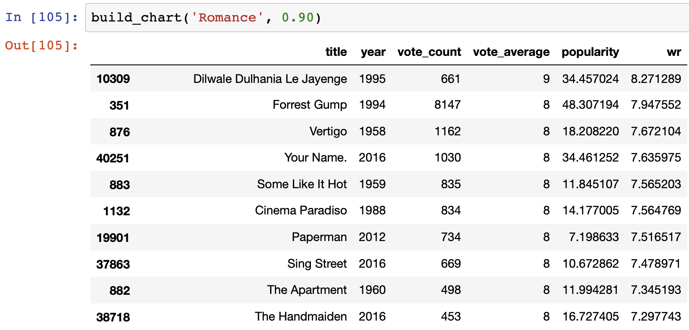

Build_chart(genre, percentile)

Slide 14
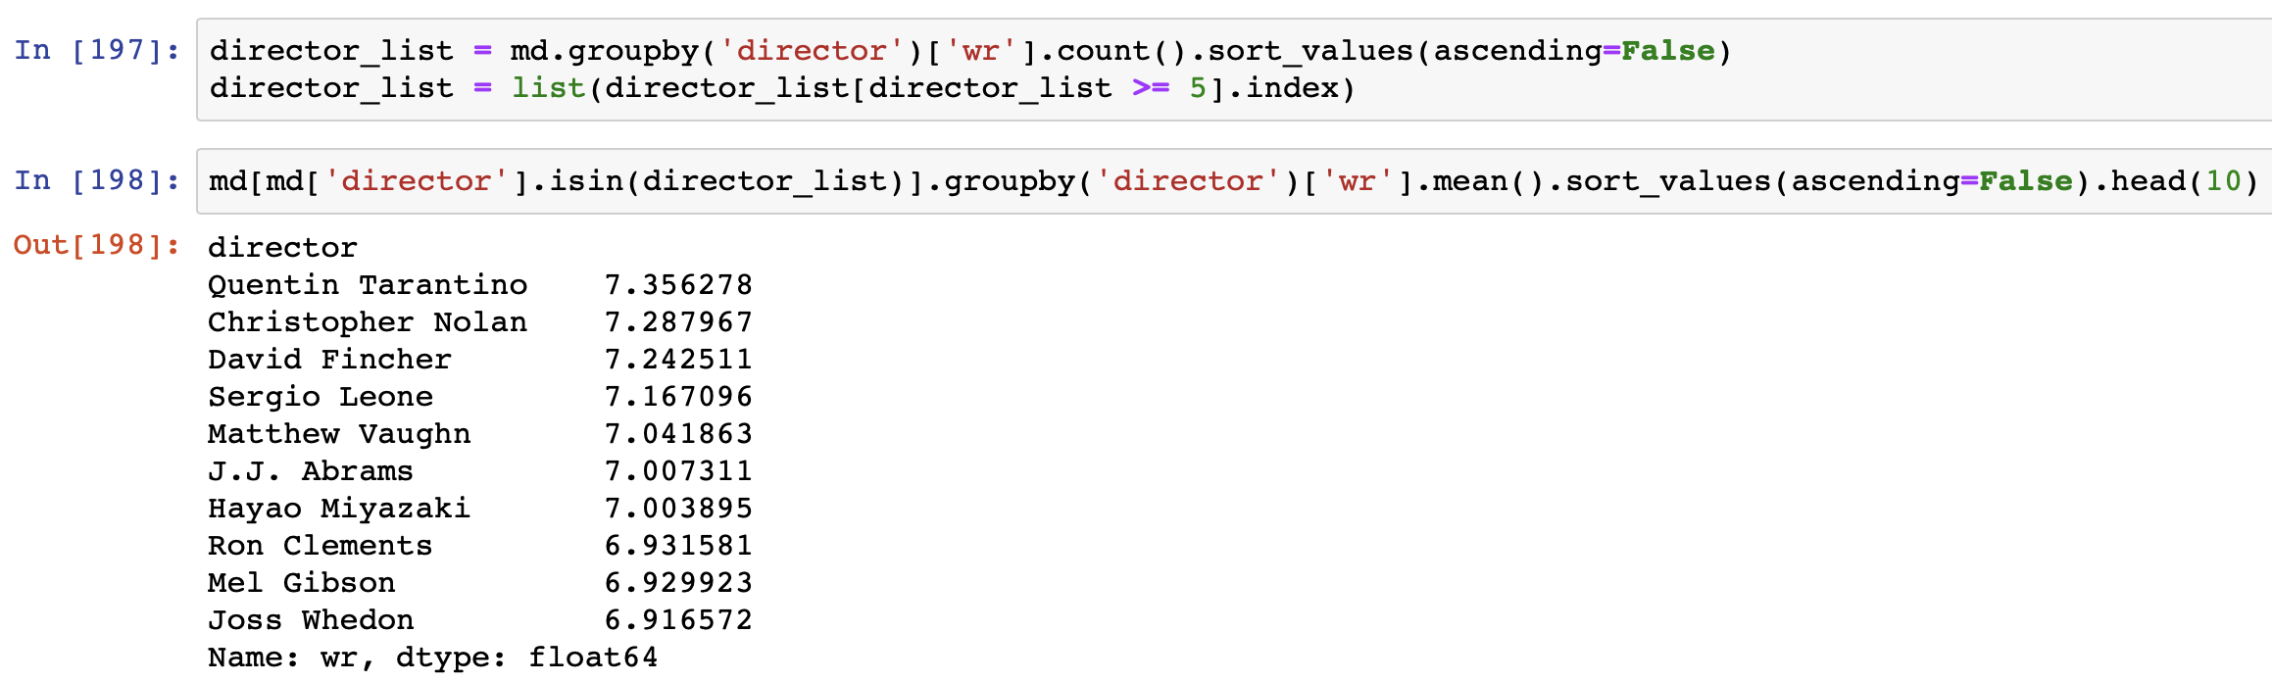

Highest Rated Directors

Slide 15
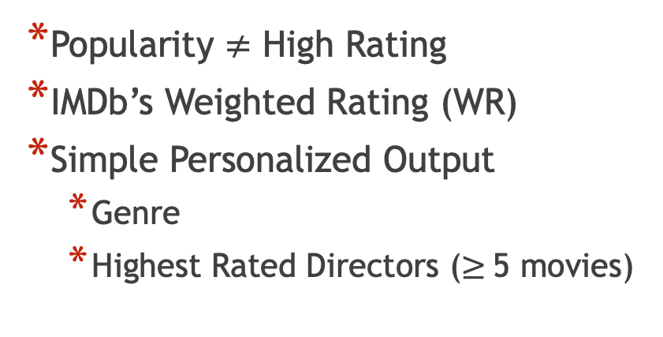
Summary
Popularity $≠$ High Rating
IMDb’s Weighted Rating (WR)
Simple Personalized Output
Genre
Highest Rated Directors ($≥$5 movies)

Slide 16
Thank you!
&
Questions?

